Slide 1
Onze presentatie 😀
Bram🤣&romano👨‍❤️‍💋‍👨&conto 👩‍🦯

Slide 2
1
file:///home/constantijn/Desktop/Opdracht%203/index.html

Slide 3
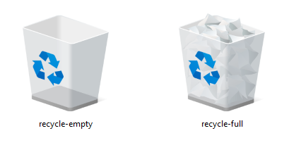
2

Slide 4
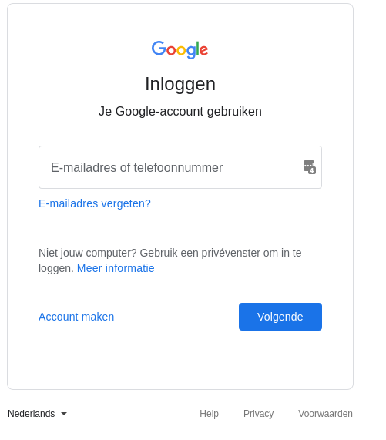
6

Slide 5
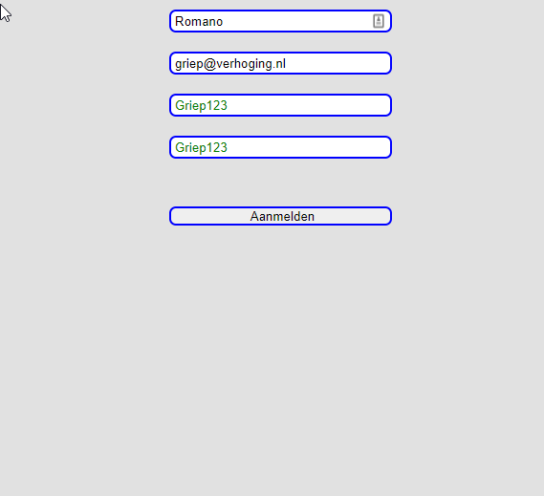
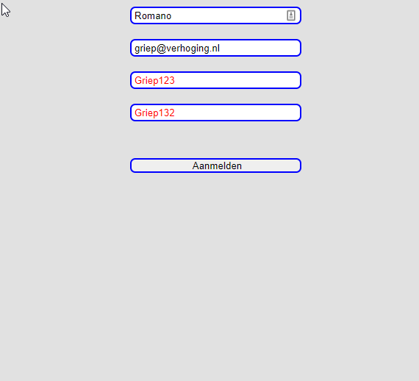
9

